Slide 1
Department of Transformation and Digitization (DTaD)
Government Services at Your Fingertips

Slide 2
Getting Started
Where Do I go?

Slide 3
Recognizing a government website
www.bahamas.gov.bs
TOP LEVEL DOMAIN = .bs (registered for The Bahamas)
Second Level Domain = .gov (Bahamas Government)

Slide 4
EXAMPLES OF GOVERNMENT SITES
BAHAMAS.GOV.BS DOMAIN
.GOV.BS DOMAIN
www.bahamas.gov.bs
www.bahamas.gov.bs/health
www.bahamas.gov.bs/finance
forms.bahamas.gov.bs
laws.bahamas.gov.bs
socialassistance.bahamas.gov.bs
opm.gov.bs
revenue.gov.bs
travel.gov.bs

Slide 5
How To Access Online Services
What do I need to do?

Slide 6
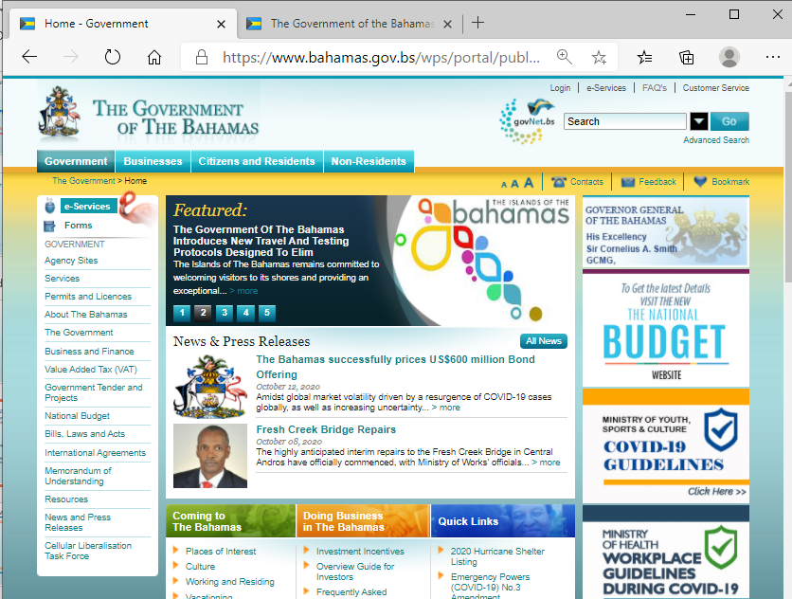
Accessing eservices
Browse to the main page of the government’s website – www.bahamas.gov.bs
Click on the eServices button on the top of the left column.

Slide 7
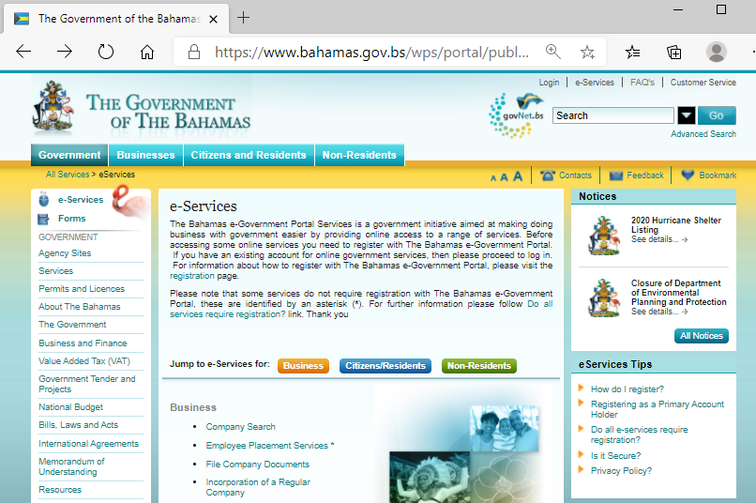
Accessing eservices – list of eservices
Click on the link for the required service.
The services are grouped by business, citizens/residents,/non-residents.

Slide 8
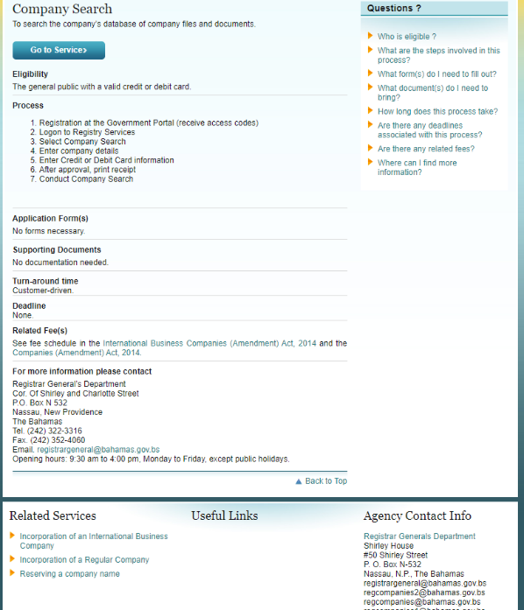
Accessing eservices - The Landing Page
The first page you access about a service may be a “landing page”
It will tell you…
About the service
What information you will need
What supporting documents (if any)
The cost (if any)
Who to contact regarding the service
Sometimes there are FAQs … frequently asked questions.
There will also be a ‘Go to Service’ button.

Slide 9
Accessing eservices – registration/login
Depending on the service, you may be required to login, or register if you have not accessed the service before. Below is some information that may be required to register for a service.
Security Questions … in case you need customer support in future.
Questions that only you or persons close to you may know
First name of your first grade teacher?
Name of your first pet?
Your favorite food?
Upload of supporting documents:
Copy of identification pages of Passport
Copy of the NIB card
You can take a picture of these documents and save them on your device.
Tax Identification Number (TIN)
Some services may require the TIN
A TIN can be obtained as a non-VAT registrant.
INLANDREVENUE.FINANCE.GOV.BS/VALUE-ADDED-TAX
Business License Number
Company Registration Number

Slide 10
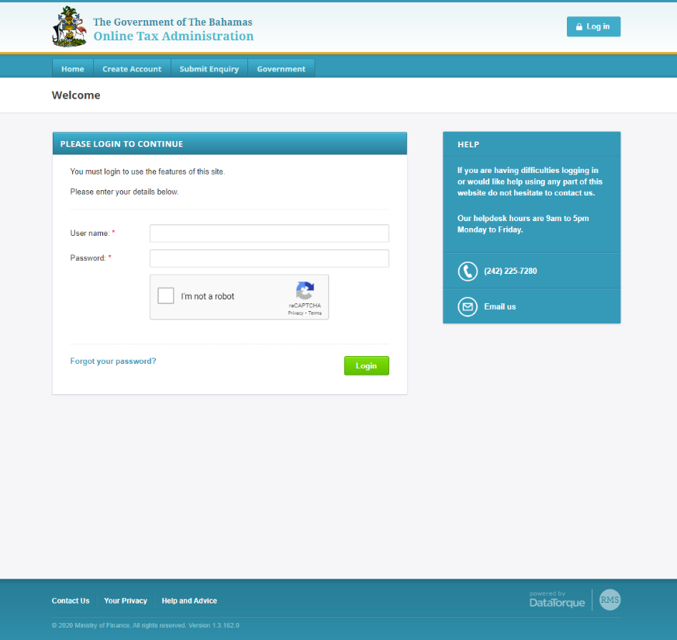
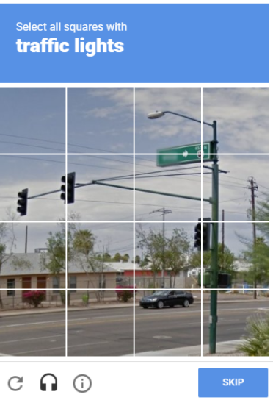
Accessing eservices – Security
Login is secured by reCaptcha functionality which prevents using bots to hack your login.
What is
this?

Slide 11
Government eServices

Slide 12
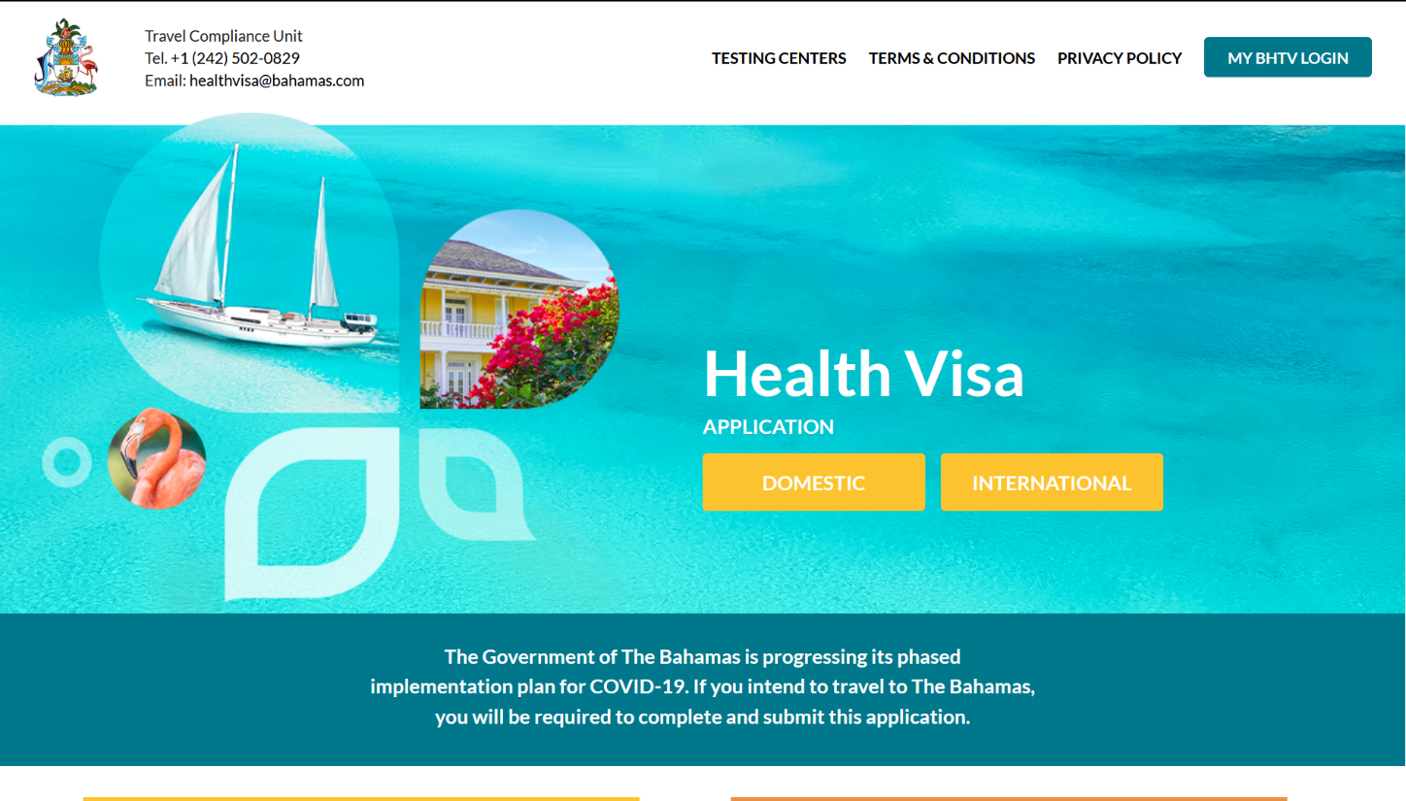
travel.gov.bs
Bahamas Domestic Travel Health Card
Bahamas Travel Health Card (International)

Slide 13
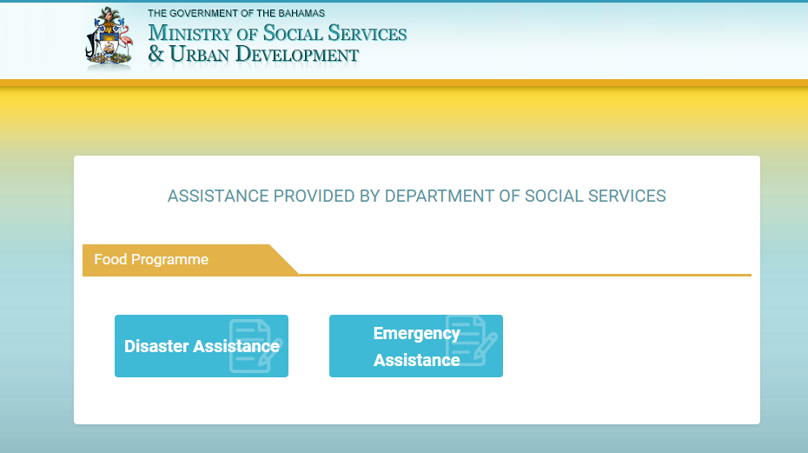
socialassistance.bahamas.gov.bs
Food assistance programmes – online application for assistance

Slide 14
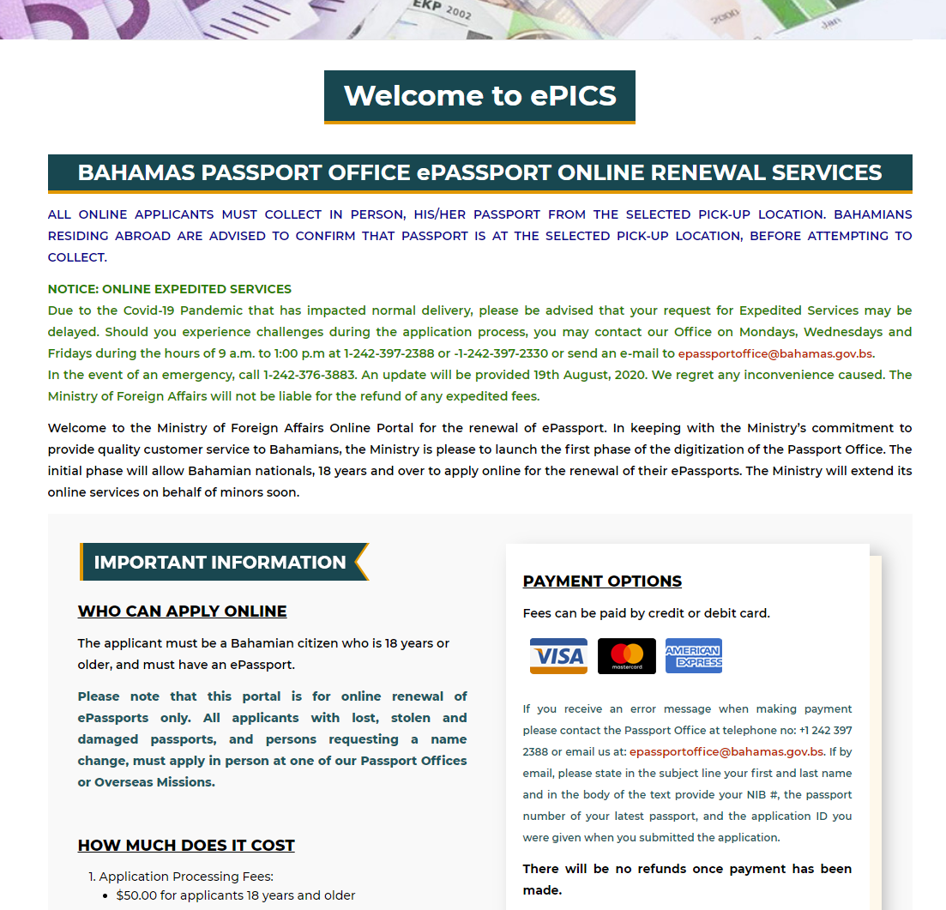
mofa.gov.bs/passportrenewal
Renewal of Passport

Slide 15
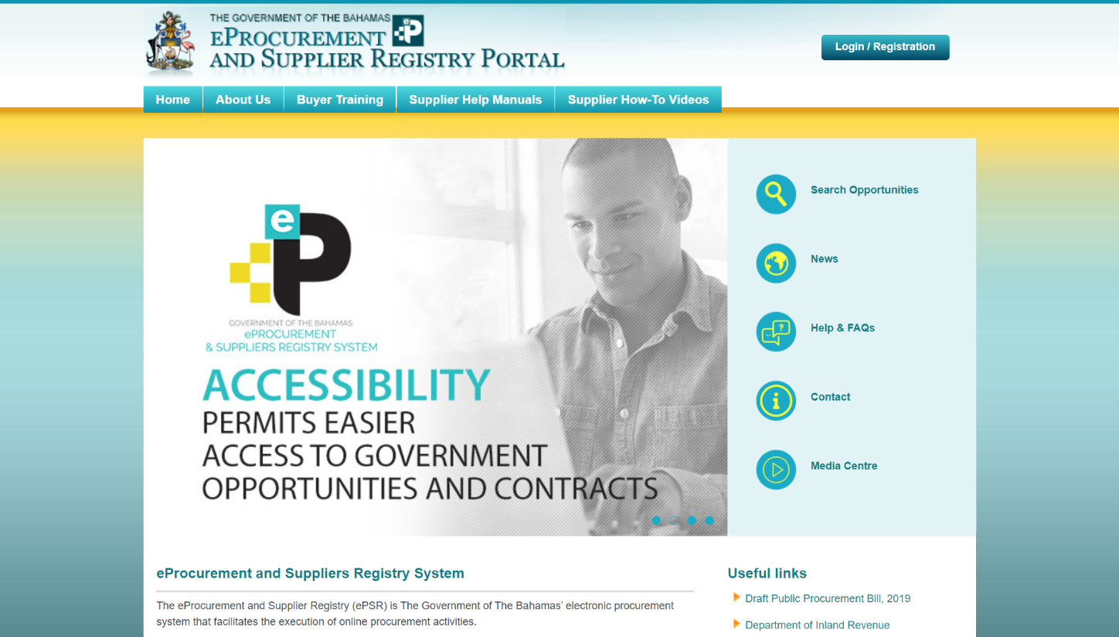
https://suppliers.gov.bs/
Suppliers Registry
Register to do business with government
Receive notifications on RFPs and RFQs based on your business category
Will expand to a full e-Procurement system for the whole of Government

Slide 16
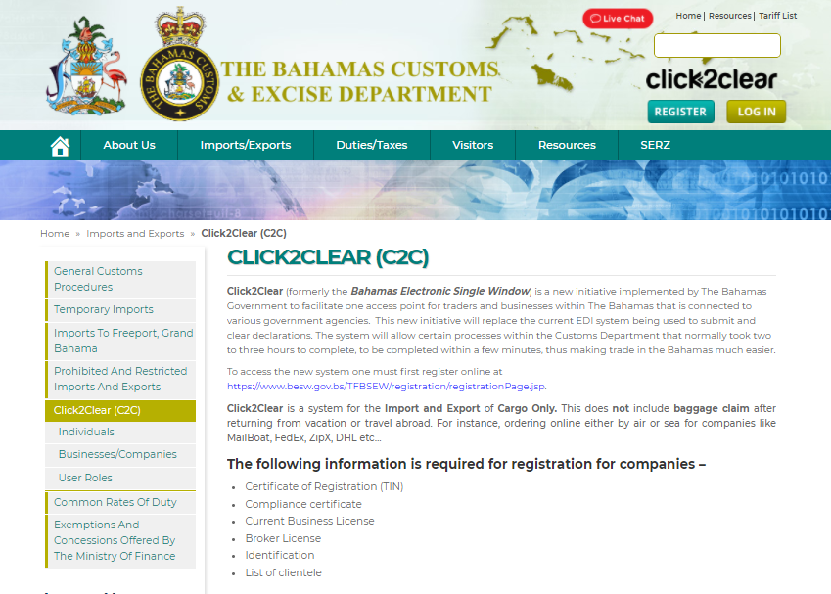
https://www.bahamascustoms.gov.bs/imports-and-exports/about-click2clear/
Single window application to submit and clear import and export declarations.

Slide 17
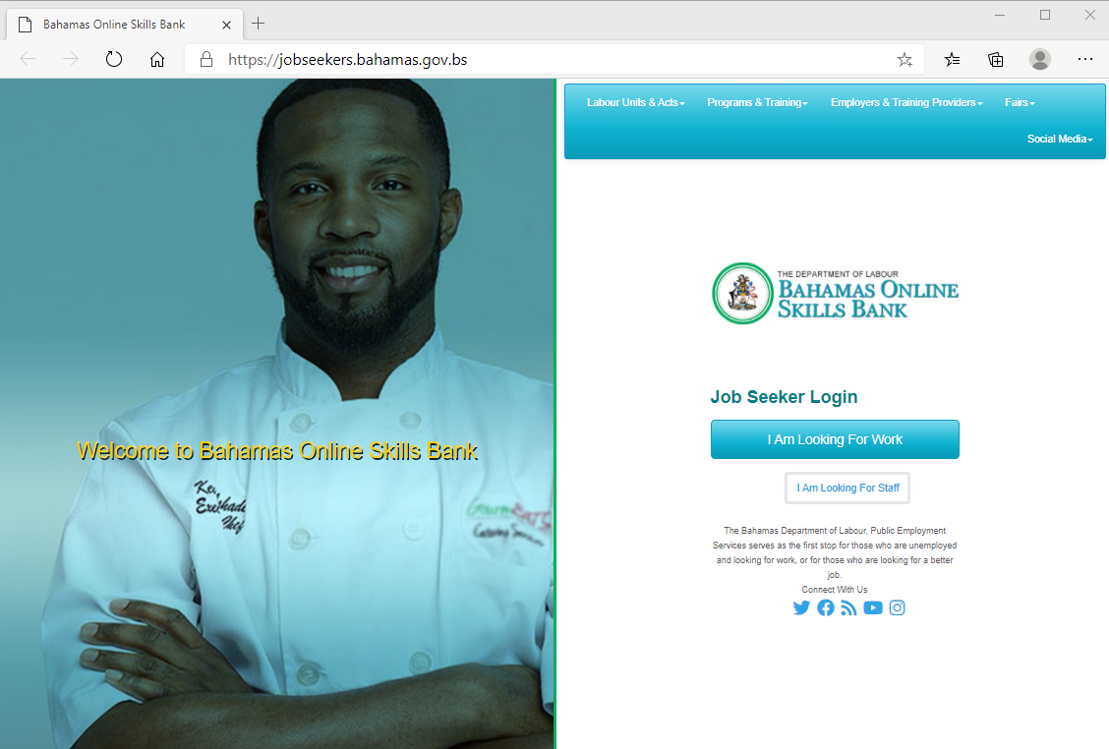
jobseekers.bahamas.gov.bs
Employment Assistance Services
>To assist nationals with finding employment.
>Allows employers to find employees by accessing DOL's skillsbank

Slide 18
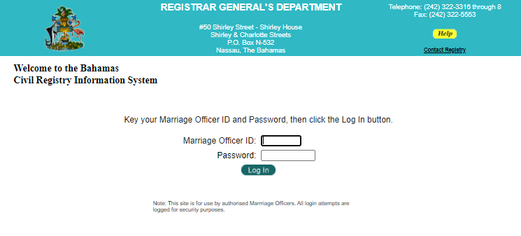
Registrar General Civil Registry Services
These services are accessed through the eServices page.
Death Registration - Used by Morticians to make a request for death registration.
Marriage Registration - Used by a Marriage Officer, when the marriage is complete, to register the marriage.
Deeds and Documents Search - Search deeds and documents online. Payment made over-the-counter. Cost based on time

Slide 19
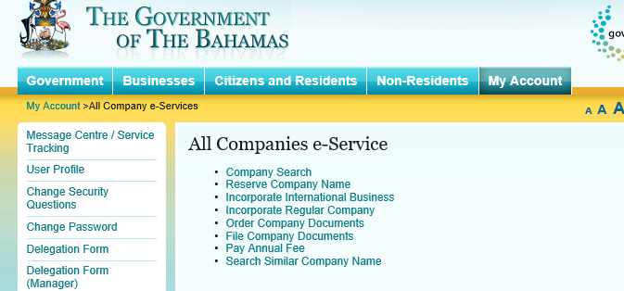
Registrar general company eServices
Services that relate to Registered Companies.
These are available to registered users once they log in.
Payments can be made online.

Slide 20
Paying Taxes

Slide 21
Paying taxes - Department of Inland Revenue
Real Property Tax
https://inlandrevenue.finance.gov.bs/real-property-tax/
Need to know your Assessment Number
Business Licence
https://inlandrevenue.finance.gov.bs/business-licence/
You would need to login at vat.revenue.gov.bs
Value Added Tax
https://inlandrevenue.finance.gov.bs/value-added-tax/
You would need to login at vat.revenue.gov.bs

Slide 22
Popular Government Sites

Slide 23
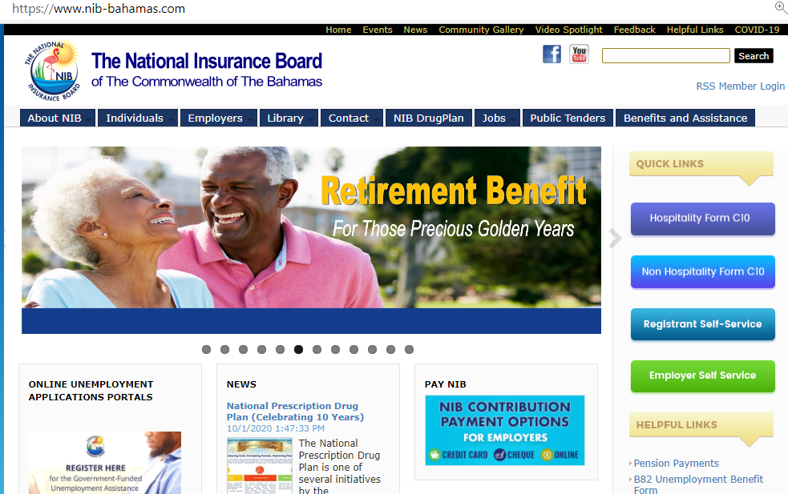
www.nib-bahamas.com
Access NIB fillable forms. Most you would download, fill in, and email back to a specified email address.
Employee Self-service
Employer Self-Service

Slide 24
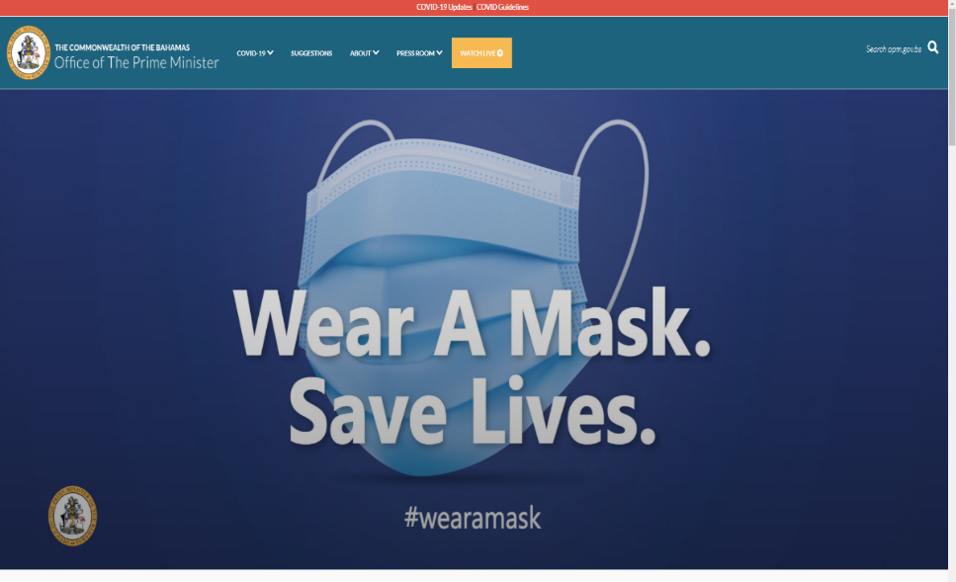
opm.gov.bs
Get all your Office of The Prime Minister updates and press releases

Slide 25
WHAT’S COMING
EPRIS – Ministry of Works “Electronic Plan Review and Inspection System”
BECMIS – Cabinet Office “Bahamas Electronic Management System”
TMS – Road Traffic Department “Transportation Management System”. Services are targeted to move online: Renewal of Driver’s License and Renewal of Vehicle Inspection and Registration
Licenses and Permits for Port Department and the Department of Marine Resources
New Digital Government Online portal which will launch over 200 services over the next 5 years.

Slide 26
THANK YOU
DEPARTMENT OF TRANSFORMATION
AND DIGITIZATION

